Slide 1

Noida Institute of Engineering and Technology, Greater Noida
Introduction to Algorithm
and Asymptotic Notations
Unit: 1
Design & Analysis of Algorithms
Renuka Sharma
Assistant Professor
CSE
B.Tech 4th Sem

Slide 2

Brief Introduction About Me
Name : Mini Jain
Designation :Assistant Professor IT & M.Tech Integrated
NIET Greater Noida
Qualification:
B.Tech R.B.S Engg. College Agra in 2018.
M.Tech R.B.S Engg. College Agra in 2020.

Slide 3

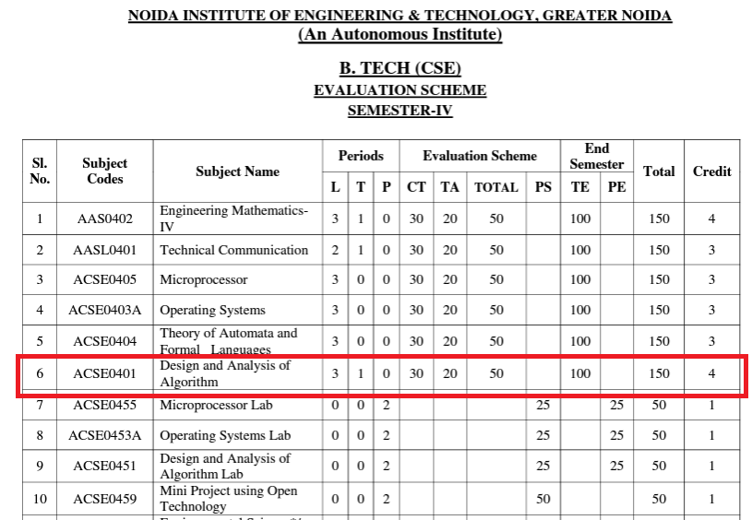
Evaluation Scheme

Slide 4
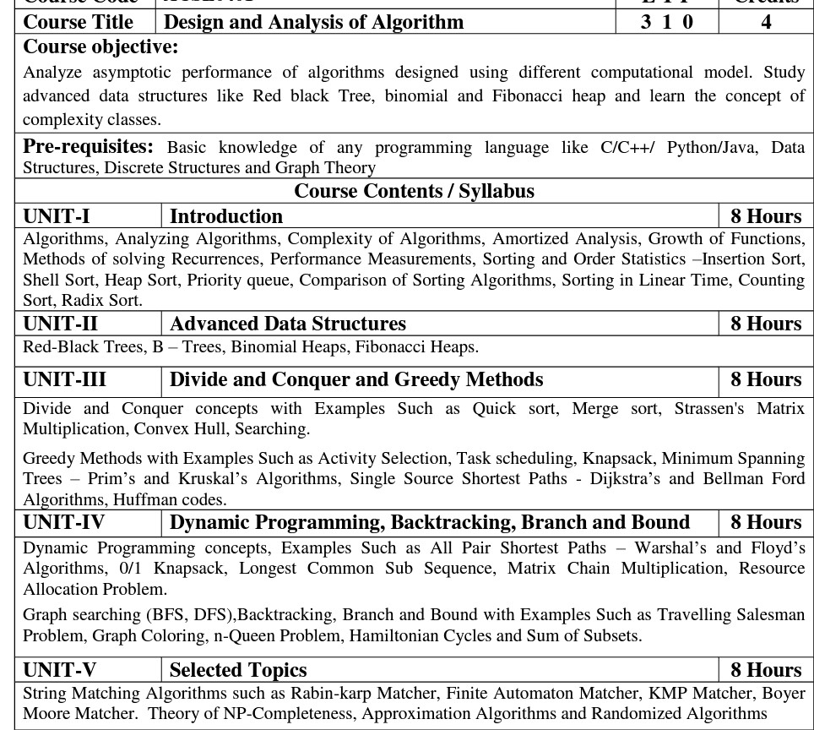
Syllabus

Slide 5
Branch wise Application
First, we will start with the internet which is very much important for our daily life and we cannot even imagine our life without the internet and it is the outcome of clever and creative algorithms. Numerous sites on the internet can operate and falsify this huge number of data only with the help of these algorithms.
The everyday electronic commerce activities are massively subject to our data, for example, credit or debit card numbers, passwords, OTPs, and many more. The centre technologies used incorporate public-key cryptocurrency and digital signatures which depend on mathematical algorithms.
Even an application that doesn't need algorithm content at the application level depends vigorously on the algorithm as the application relies upon hardware, GUI, networking, or object direction and all of these create a substantial use of algorithms.
There are some other vital use cases where the algorithm has been used such as if we watch any video on YouTube then next time we will get related-type advice as recommended videos for us.

Slide 6
Course Objective
Upon completion of this course, students will be able to do the following:
Analyze the asymptotic performance of algorithms.
Write rigorous correctness proofs for algorithms.
Demonstrate a familiarity with major algorithms and data structures.
Apply important algorithmic design paradigms and methods of analysis.
Synthesize efficient algorithms in common engineering design situations.

Slide 7
Course Outcome
At the end of the semester, the student will be able:
 | Description | Bloom’s Taxonomy
CO1 | To have knowledge of basic principles of algorithm design and Analysis, asymptotic notations and growth of functions for time and space complexity analysis and applying the same in different sorting algorithms | Knowledge, analysis And design
CO2 | To apply different problem-solving approaches for advanced data structures | Knowledge, analysis And apply
CO3 | To apply divide and conquer method for solving merge sort, quick sort, matrix multiplication and Greedy Algorithm for solving different Graph Problem. | Knowledge, analysis and Apply
CO4 | To analyze and apply different optimization techniques like dynamic programming, backtracking and Branch & Bound to solve the complex problems | Knowledge, Analysis And Apply
CO5 | To understand the advanced concepts like NP Completeness and Fast Fourier Transform, to analyze and apply String Matching, Approximation and Randomized Algorithms to solve the complex problems | Knowledge, Analysis and Apply

Slide 8
Program Outcome
At the end of the semester, the student will be able:
POs | Engineering Graduates will be able to
PO1 | Engineering Knowledge
PO2 | Problem Analysis
PO3 | Design & Development of solutions
PO4 | Conduct Investigation of complex problems
PO5 | Modern Tool Usage
PO6 | The Engineer and Society
PO7 | Environment and sustainability
PO8 | Ethics
PO9 | Individual & Team work
PO10 | Communication
PO11 | Project management and Finance
PO12 | Life Long Learning

Slide 9
CO-PO and PSO Mapping
Design and Analysis of Algorithm (kCS-502)
CO.K | PO1 | PO2 | PO3 | PO4 | PO5 | PO6 | PO7 | PO8 | PO9 | PO10 | PO11 | PO12
ACSE0401.1 | 3 | 3 | 3 | 3 | 2 | - | - | - | 2 | 2 | - | 3
ACSE0401.2 | 3 | 3 | 3 | 3 | 2 | 2 | - | 1 | 1 | 1 | - | 3
ACSE0401.3 | 3 | 3 | 2 | 3 | 3 | 2 | - | 2 | 1 | 1 | 2 | 3
ACSE0401.4 | 3 | 3 | 3 | 3 | 2 | 2 | - | 2 | 2 | 1 | 3 | 3
ACSE0401.5 | 2 | 2 | 2 | 2 | 2 | 2 | - | 2 | 1 | 1 | 1 | 2
Average | 2.8 | 2.8 | 2.6 | 2.8 | 2.2 | 1.6 | - | 1.8 | 1.4 | 1.2 | 1.2 | 2.8

Slide 10
Program Educational Objectives(PEOs)
PEO1: To have an excellent scientific and engineering breadth so as to
comprehend, analyze, design and provide sustainable solutions for
real-life problems using state-of-the-art technologies.
PEO2:To have a successful career in industries, to pursue higher studies or
to support enterpreneurial endeavors and to face global challenges.
PEO3:To have an effective communication skills, professional attitude,
ethical values and a desire to learn specific knowledge in emerging
trends, technologies for research, innovation and product
development and contribution to society.
PEO4: To have life-long learning for up-skilling and re-skilling for
successful professional career as engineer, scientist, enterpreneur
and bureaucrat for betterment of society

Slide 11
Result Analysis

Slide 12
End Semester Question Paper Template
B TECH
(SEM-V) THEORY EXAMINATION 20__-20__
DESIGN AND ANALYSIS OF ALGORITHMS
Time: 3 Hours Total Marks: 100
Note: 1. Attempt all Sections. If require any missing data; then choose suitably.
SECTION A
Attempt all questions in brief. 2 x 10 = 20
Q.No. | Question | Marks | CO
1 |  | 2
2 |  | 2
. |  | .
10 |  | 2

Slide 13
End Semester Question Paper Templates
SECTION B
2. Attempt any three of the following: 3 x 10 = 30
SECTION C
3. Attempt any one part of the following: 1 x 10 = 10
Q.No. | Question | Marks | CO
1 |  | 10
2 |  | 10
. |  | .
5 |  | 10
Q.No. | Question | Marks | CO
1 |  | 10
2 |  | 10

Slide 14
End Semester Question Paper Templates
4. Attempt any one part of the following: 1 x 10 = 10
5. Attempt any one part of the following: 1 x 10 = 10
6. Attempt any one part of the following: 1 x 10 = 10
Q.No. | Question | Marks | CO
1 |  | 10
2 |  | 10
Q.No. | Question | Marks | CO
1 |  | 10
2 |  | 10
Q.No. | Question | Marks | CO
1 |  | 10
2 |  | 10

Slide 15
Prerequisite and Recap
Prerequisite
Basic concept of c programming language.
Concept of stack, queue and link list.
Recap
Flow Chart
Algorithm

Slide 16
Introduction About Subject With Videos
The word Algorithm means “a process or set of rules to be followed in calculations or other problem-solving operations”. Therefore Algorithm refers to a set of rules/instructions that step-by-step define how a work is to be executed upon in order to get the expected results.
https://youtu.be/6hfOvs8pY1k

Slide 17
Unit Content
Introduction to Algorithm
Characteristics of Algorithm
Analysis of Algorithm
Asymptotic Notations
Recurrence Relation
Sorting and order Statistics
Shell sort,
Heap sort,
Sorting in linear time
.

Slide 18
Unit Objective
This is an introductory chapter of Design & Analysis of Algorithm covering the concept, importance and characteristics of algorithms. The complexity and its calculation has been explained. Further, recursion and different methodologies to solve them have also been provided.
In other part of unit different sorting algorithm – Insertion, Heap sort, Quick sort, bucket sort, Radix Sort and Counting sort have been discussed along with their complexities
.

Slide 19
Topic Objective
The objective of this topic is to make students understand about
Need of algorithm
Problem statement
Why study algorithm
Characteristics of Algorithm

Slide 20
Introduction to the Algorithm(CO1)
An algorithm provides a step-by-step method for solving a computational problem, algorithms are not dependent on a particular programming language, machine, system, or compiler.
Problem
Algorithm
Input output
Computer

Slide 21
Algorithm
The Study of algorithm is necessary from the following point of view.
Algorithm help us to understand scalability.
Efficient algorithm leads to efficient program.
Efficient program clear and unabiguous
Efficient program make better use of hardware.

Slide 22
Characteristics of Algorithm
Correctness
Efficiency
Simplicity
Generality
Non Ambiguity

Slide 23
Algorithm
All algorithms must satisfy following criteria-:
Input
Output
Definiteness
Finiteness
Effectiveness

Slide 24
Algorithm
An algorithm is a set of steps of operations to solve a problem.
An algorithm is an efficient method that can be expressed within finite amount of time and space.
Algorithm is independent from any programming languages.
Algorithm design include creating an efficient algorithm to solve a problem in an efficient way using minimum time and space.
Time is directly proportional to the number of operations on a program.

Slide 25
Analysis of Algorithm(CO1)- Objective
The objective of this topic is to make students understand about
Space Complexity
Time Complexity
Best Case
Worst Case
Average Case

Slide 26
Prerequisite and Recap
Prerequisite
Definition of algorithm
Recap
Characteristics of algorithm

Slide 27
Analysis of Algorithm(CO1)
The term "analysis of algorithms" was coined by Donald Knuth.
To estimate the complexity function for arbitrarily large input.
Analysis of algorithms is the determination of the amount of time and space resources required to execute it.
The efficiency or running time of an algorithm is stated as a function relating the input length to the number of steps, known as time complexity, or volume of memory, known as space complexity.
The main concern of analysis of algorithms is the required time or performance

Slide 28
Analysis of Algorithm(CO1)
How to measure time
Count total number of fundamental operation in program and this total will give the rough estimate of the running time in terms of input size.
Best Case
The minimum number of steps taken on any instance of size n.
Average Case
An average number of steps taken on any instance of size n.
Worst Case
The maximum number of steps taken on any instance of size n.

Slide 29
Asymptotic Notations(CO1)- Objective
The objective of this topic is to make students understand about
Five Asymptotic notations
Big Oh Notation
Big Omega Notation
Big Theta Notation
Small Oh Notation
Small Omega Notation

Slide 30
Prerequisite and Recap
Prerequisite
Definition of algorithm
Recap
Cases of analysis of algorithm

Slide 31
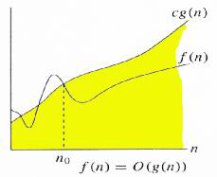
Big Oh Notation
The function f(n) = O(g(n)) (read as “ f of n is big oh of g of n”) if there exist positive constants c and n0 such that
f(n)≤cg(n) for all n≥ n0

Slide 32
Big Oh Notation
Example
Let us consider a given function,
f(n)=4.n³+10.n²+5.n+1
Considering g(n)=n³,
f(n)⩽5.g(n) for all the values of n>2.
Hence, the complexity of f(n) can be represented as
O(g(n)), i.e. O(n³)

Slide 33
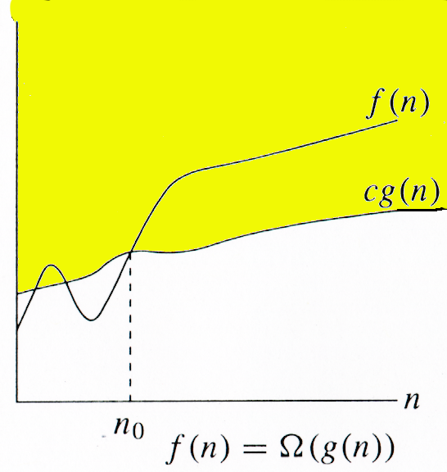
Big Omega Notation
The function f(n) = Ω(g(n)) (read as “ f of n is Ω of g of n”) if there exist positive constants c and n0 such that
cg(n)≤ f(n) for all n≥ n0

Slide 34
Big Omega Notation
Example
Let us consider a given function,
f(n)=4.n³+10.n²+5.n+1
Considering g(n)=n³,
f(n) ≥ 4.g(n) for all the values of n>0.
Hence, the complexity of f(n) can be represented as
Ω (g(n)), i.e. Ω(n³)

Slide 35
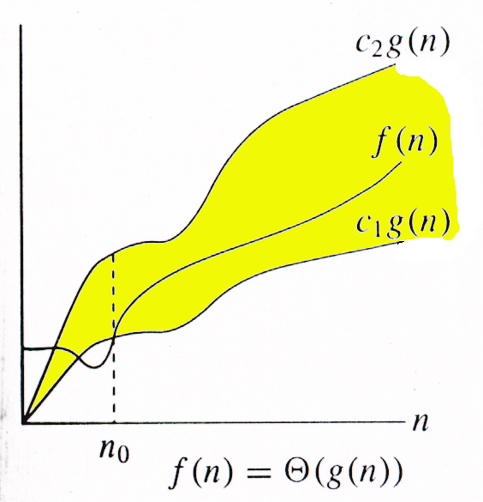
Big Theta Notation
The function f(n) = Θ(g(n)) (read as “ f of n is theta of g of n”) if there exist positive constants c1 and c2 and n0 such that
c1g(n)≤f(n)≤c2g(n) for all n≥ n0

Slide 36
Big Theta Notation
Example
Let us consider a given function,
f(n)=4.n³+10.n²+5.n+1
Considering g(n)=n³,
4.g(n)⩽f(n)⩽5.g(n) for all the large values of n.
Hence, the complexity of f(n) can be represented as
θ(g(n)), i.e. θ(n³)

Slide 37
Small Oh Notation
Upper bound that is not asymptotically tight
f(n) = o(g(n)) if f(n)< c(g(n)) for all n≥ n0
f(n) becomes insignificant relative to g(n) as n approaches infinity:
lim [f(n) / g(n)] = 0
^{n→∞}
g(n) is an upper bound for f(n) that is not asymptotically tight.

Slide 38
Small Oh Notation
Example
Let us consider a given function,
f(n)=4.n³+10.n²+5.n+1
Considering g(n)=n⁴,
lim (4.n³+10.n²+5.n+1/ n⁴ )=0
n→∞
Hence, the complexity of f(n) can be represented as
o(g(n)), i.e. o(n⁴)

Slide 39
Small Omega Notation
lower bound that is not asymptotically tight
f(n) = ω(g(n)) if c(g(n))< f(n) for all n≥ n0
f(n) becomes arbitrarily large relative to g(n) as n approaches infinity:
lim [f(n) / g(n)] = ∞.
^{n→∞}
g(n) is a lower bound for f(n) that is not asymptotically tight.

Slide 40
Small Omega Notation
Example
Let us consider a given function,
f(n)=4.n³+10.n²+5.n+1
Considering g(n)=n²,
lim (4.n³+10.n²+5.n+1/ n² )=0
n→∞
Hence, the complexity of f(n) can be represented as
ω (g(n)), i.e. ω(n⁴)

Slide 41
Recursion (CO1)- Objective
The objective of this topic is to make students understand about
Different methods of solving recursion
Substitution/ Iteration method
Recursion Tree method
Master method

Slide 42
Prerequisite and Recap
Prerequisite
Algorithm
Mathematical concepts of limits and summation
Recap
Asymptotic notations

Slide 43
Recursion (CO1)
The process in which a function calls itself directly or indirectly is called recursion and the corresponding function is called as recursive function.
Using recursive algorithm, certain problems can be solved quite easily.
Examples of such problems are Towers of Hanoi (TOH), Inorder/Preorder/Postorder Tree Traversals, DFS of Graph, etc.
The running time of recursive algorithms is represented by an equation that describes a function in terms of its value on smaller functions. For eg.
T(n) = {
C n=1
2T(n/2) +cn n>1

Slide 44
Recursion
There are three methods to solve recurrence
Substitution/ Iteration method
Recursion Tree method
Master method

Slide 45
Recursion
Substitution/ Iteration method
Guess the form of the answer by experience and creativity or by some heuristics guess the form of the solution. And then use induction to find the constants and show that solution works.
Example Solve T(n)=T(n-1) + 1 and T(1) = Ө(1)
T(n) = T(n-2) +1+1
T(n) = T(n-3) +1+1+1
T(n) = T(n-4) +1+1+1+1
And so on T(n) = T(n-k) + k
Where n-k =1 => n-k=1
Thus T(n)= T(1) + n-1⇒Ө(n)

Slide 46
Recursion
Recursion Tree Method
Each node represents the cost of a single sub problem.
Sum up the costs with each level to get level cost.
Sum up all the level costs to get total cost.
Particularly suitable for divide-and-conquer recurrence.
Best used to generate a good guess.
If trying carefully to draw the recursion-tree and compute cost, then used as direct proof.
Example Recursion Tree ofT(n)=2T(n/2)+ C
T(n)=2T(n/2)+ n

Slide 47
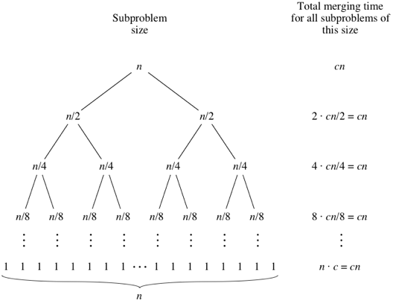
Recursion

Slide 48
Recursion
Master method
Master Method is a direct way to get the solution.
The master method applies to recurrences of the form
T(n) = a T(n/b) + f (n) ,
where a ≥ 1, b > 1, and f is asymptotically positive.

Slide 49
Recursion
There are three cases:
Case I f (n) = O(n^{logba – ε}) for some constant ε > 0.
f (n) grows polynomially slower than n^{logba} (by an n^{ε} factor).
Solution: T(n) = Θ(n^{logba})
Example
. T(n) = 4T(n/2) + n
Here a = 4, b = 2 ⇒ n^{logba} = n²; f (n) = n.
CASE 1: f (n) = O(n^{2 – ε}) for ε = 1.
∴ T(n) = Θ(n²).

Slide 50
Recursion
Case II f (n) = Θ(n^{logba} lg^{k}n) for some constant k ≥ 0.
f (n) and n^{logba} grow at similar rates.
Solution: T(n) = Θ(n^{logba} lg^{k+1}n) .
Example
T(n) = 4T(n/2) + n²
Here a = 4, b = 2 ⇒ n^{logba} = n²; f (n) = n².
CASE 2: f (n) = Θ(n²lg⁰n), that is, k = 0.
∴ T(n) = Θ(n²lg n).

Slide 51
Recursion
Case III f (n) = Ω(n^{logba + ε}) for some constant ε > 0.
f (n) grows polynomials faster than n^{logba} (by an n^{ε} factor),
and f (n) satisfies the regularity condition that a f (n/b) ≤ c f (n) for some constant c < 1.
Solution: T(n) = Θ( f (n) ) .
Example
T(n) = 4T(n/2) + n³
a = 4, b = 2 ⇒ n^{logba} = n²; f (n) = n³.
CASE 3: f (n) = Ω(n^{2 + ε}) for ε = 1 and 4(cn/2)³ ≤ cn³ for c = 1/2.
∴ T(n) = Θ(n³).

Slide 52
Recursion
Examples of some standard algorithms whose time complexity can be evaluated using Master Method
Merge Sort: T(n) = 2T(n/2) + Θ(n). It falls in case 2 as c is 1 and Log_{b}a] is also 1. So the solution is Θ(n Logn)
Binary Search: T(n) = T(n/2) + Θ(1). It also falls in case 2 as c is 0 and Log_{b}a is also 0. So the solution is Θ(Logn)

Slide 53
Sorting(CO1)- Objective
The objective of this topic is to make students understand about
Different Sorting Tehniques
Insertion sorting
Heap Sort
Counting Sort
Bucket Sort
Radix Sort

Slide 54
Prerequisite and Recap
Prerequisite
Algorithm
loops- for while
C programming
Recap
Recursion

Slide 55
Sorting(CO1)
Insertion Sort
Insertion sort is a simple sorting algorithm that works similar to the way you sort playing cards in your hands.
The array is virtually split into a sorted and an unsorted part.
Values from the unsorted part are picked and placed at the correct position in the sorted part.
Characteristics of Insertion Sort:
This algorithm is one of the simplest algorithm with simple implementation
Basically, Insertion sort is efficient for small data values

Slide 56
Sorting(CO1)
Insertion Sort Algorithm
Algorithm: We use a procedure INSERTION_SORT. It takes as parameters an array A[1.. n] and the length n of the array.
INSERTION_SORT (A)
1. FOR j ← 2 TO length[A]
2. DO key ← A[j]
3. //{Put A[j] into the sorted sequence A[1 . . j − 1]}
4. i ← j − 1
5. WHILE i > 0 and A[i] > key
6. DO A[i +1] ← A[i]
7. i ← i − 1
8. A[i + 1] ← key

Slide 57
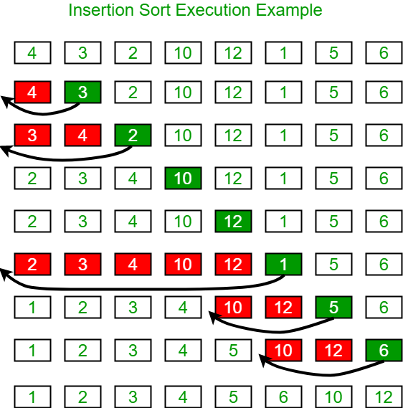
Sorting(CO1)

Slide 58
Sorting(CO1)
Insertion Sort
Three Cases:
Best-Case The best case occurs if the array is already sorted. the while-loop in line 5 executed only once for each j. This happens if given array A is already sorted. T(n) = an + b = O(n) It is a linear function of n.
Worst case The worst-case occurs if the array is sorted in reverse order i.e., in decreasing order. the worst-case occurs, when line 5 executed j times for each j. This can happens if array A starts out in reverse order T(n) = an² + bn + c = O(n²)
Average case: When half of the array is sorted and half of the array is unsorted it produces O(n²)

Slide 59
Sorting(CO1)
Heap Sort
Heap sort is a comparison based sorting technique based on Binary Heap data structure.
The binary heap data structure is an array that can be viewed as almost complete binary tree.
Each node of the binary tree corresponds to an element of the array.
It is similar to selection sort where we first find the maximum element and place the maximum element at the end.
We repeat the same process for remaining element.

Slide 60
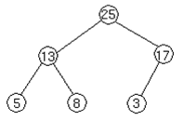
Sorting(CO1)
Heap Sort
For Example
We represent heaps in level order, going from left to right.
The array corresponding to the heap above is [25, 13, 17, 5, 8, 3].

Slide 61
Sorting(CO1)
Heap Sort
The root of the tree A[1] and given index i of a node, the indices of its parent, left child and right child can be computed as
PARENT (i) = return floor(i/2)
LEFT (i) = return 2i
RIGHT (i) = return 2i + 1

Slide 62
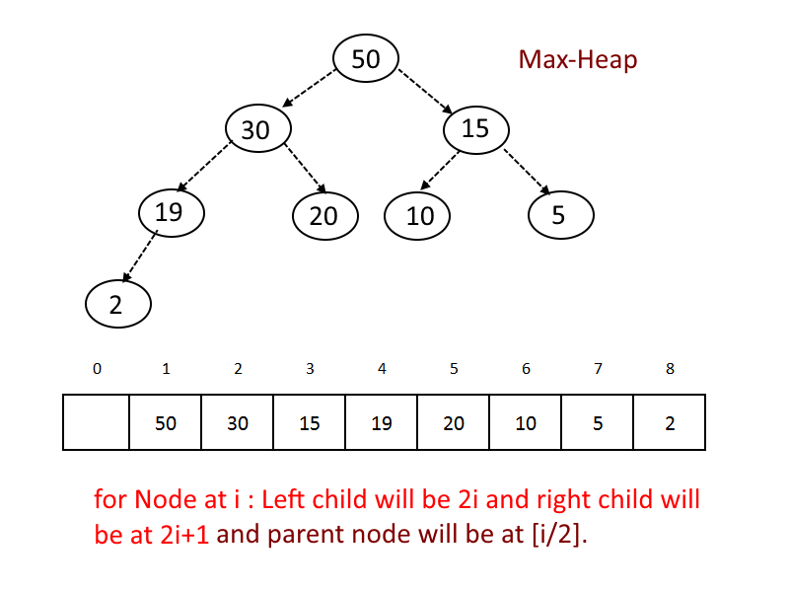
Sorting(CO1)
Heap Property
Max-heap property: A max-heap is a binary tree such that. - the data contained in each node is greater than (or equal to) the data in that node's children. ie. for every node i other than the root A[PARENT(i)] >= A[i]

Slide 63
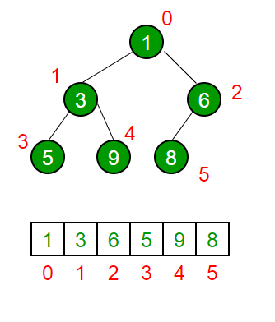
Sorting(CO1)
2. Min-heap property: A min-heap is a binary tree such that. - the data contained in each node is less than (or equal to) the data in that node's children. - the binary tree is complete
for every node i other than the root
A[PARENT(i)] <= A[i]

Slide 64
Sorting(CO1)
Four basic procedures on heap are
1. Heapify, which runs in O(lg n) time.
2. Build-Heap, which runs in linear time.
3. Heap Sort, which runs in O(n lg n) time

Slide 65
Sorting(CO1)
Heapify (A, i)
1. l ← left [i]
2. r ← right [i]
3. if l ≤ heap-size [A] OR A[l] > A[i]
4. then largest ← l
5. else largest ← i
6. if r ≤ heap-size [A] OR A[r] > A[largest]
7. then largest ← r
8. if largest ≠ i
9. then exchange A[i] ↔ A[largest]
10. Heapify (A, largest)

Slide 66
Sorting(CO1)
Build Max Heap (A)
1. heap-size [A] ← length [A]
2. For i ← lower bound (length [A])/2 down to 1
3. Do Max Heapify [A, i]

Slide 67
Sorting(CO1)
Characteristics of Heap Sort Algorithm
The heap sort combines the best of both merge sort and insertion sort. Like merge sort, the worst case time of heap sort is O(n log n) and like insertion sort, heap sort sorts in-place.
The heap sort algorithm starts by using procedure BUILD-HEAP to build a heap on the input array A[1 . . n].
Since the maximum element of the array stored at the root A[1], it can be put into its correct final position by exchanging it with A[n] (the last element in A).
If we now discard node n from the heap than the remaining elements can be made into heap. Note that the new element at the root may violate the heap property.

Slide 68
Sorting(CO1)
Heap Sort Algorithm
HEAPSORT (A)
1. BUILD_HEAP (A)
2. for i ← length (A) down to 2 do
exchange A[1] ↔ A[i]
heap-size [A] ← heap-size [A] - 1
Heapify (A, 1)
The HEAPSORT procedure takes time O(n lg n), since the call to BUILD_HEAP takes time O(n) and each of the n -1 calls to Heapify takes time O(lg n).

Slide 69
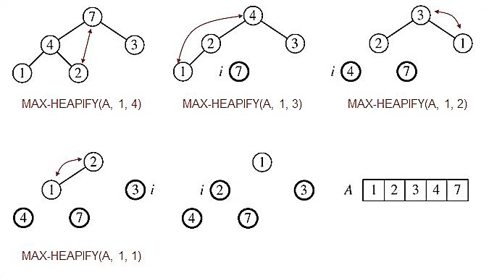
Sorting(CO1)
Example: A=[7, 4, 3, 1, 2]

Slide 70
Sorting(CO1)
Counting Sort
Counting sort is a stable sorting technique, which is used to sort objects according to the keys that are small numbers.
It counts the number of keys whose key values are same.
This sorting technique is effective when the difference between different keys are not so big, otherwise, it can increase the space complexity
It works by counting the number of objects having distinct key values (kind of hashing).
Then there will be some arithmetic to calculate the position of each object in the output sequence.

Slide 71
Sorting(CO1)
Counting Sort
Depends on a key assumption: numbers to be sorted are integers in
{0, 1, . . . , k}.
• Input: A[1 . . n], where A[ j ] Î {0, 1, . . . , k} for j = 1, 2, ..., n. Array A
and values n and k are given as parameters.
• Output: B[1 . . n], sorted. B is assumed to be already allocated and is
given as a parameter.
• Auxiliary storage: C[0 . . k]

Slide 72
Sorting(CO1)
COUNTING_SORT (A, B, k)
1. for i ← 0 to k do
2. c[i] ← 0
3. for j ← 1 to length[A] do
4. c[A[j]] ← c[A[j]] + 1
5. //c[i] now contains the number of elements equal to i
6. for i ← 1 to k do
7. c[i] ← c[i] + c[i-1]
8. // c[i] now contains the number of elements ≤ i
9. for j ← length[A] downto 1 do
10. B[c[A[j]]] ← A[j]
c[A[j]] ← c[A[j]] – 1
Analysis-The average time complexity for Bucket Sort is O(n + k). The worst time complexity is O(n²). The space complexity for Bucket Sort is O(n+k).

Slide 73
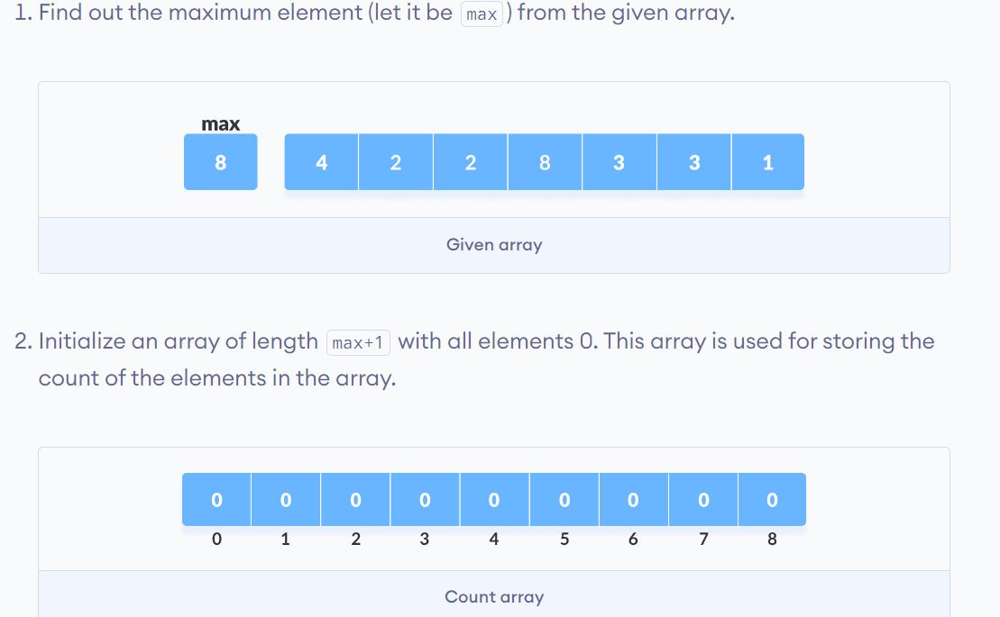
Sorting(CO1)
Counting Sort

Slide 74
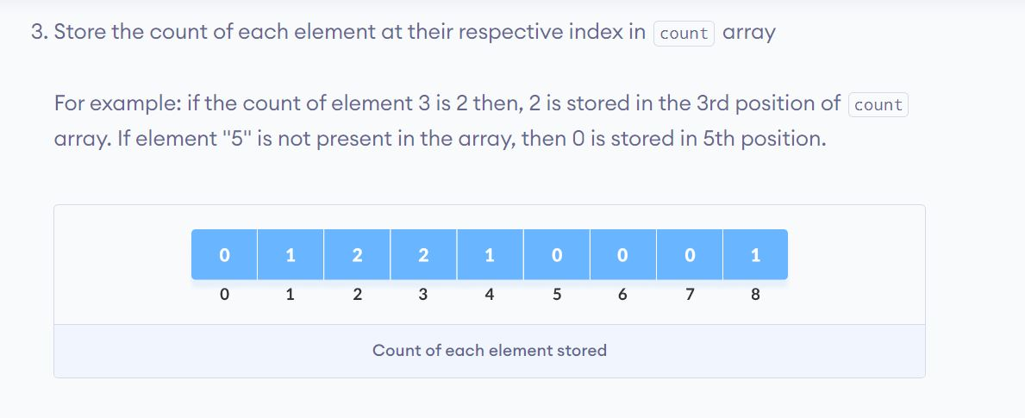
Sorting(CO1)
Counting Sort

Slide 75
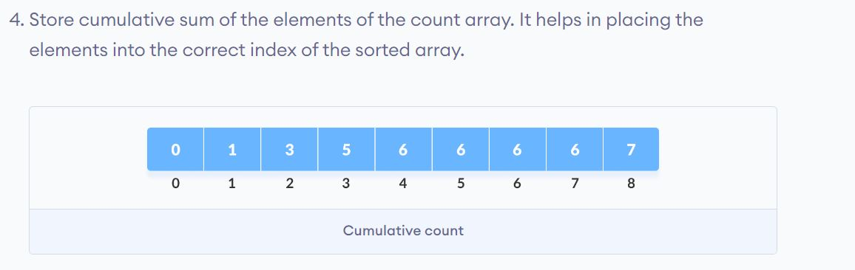
Sorting(CO1)
Counting Sort

Slide 76
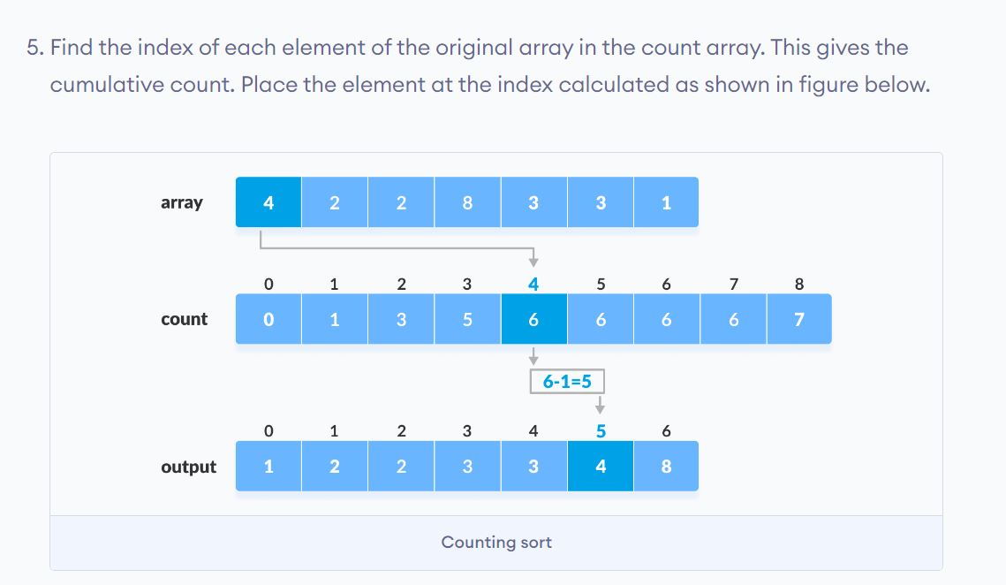
Sorting(CO1)
Counting Sort

Slide 77
Sorting(CO1)
Radix Sort
The idea of Radix Sort is to do digit by digit sort starting from least significant digit to most significant digit.
Radix sort uses counting sort as a subroutine to sort.
Radix sort is a non-comparative integer sorting algorithm that sorts data with integer keys by grouping keys by the individual digits which share the same significant position and value.
To sort d digits:
RADIX_SORT (A, d)
for i ← 1 to d do
use a stable sort to sort A on digit i
// counting sort will do the job

Slide 78
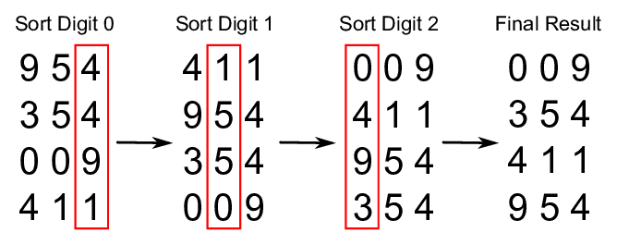
Sorting(CO1)
Radix Sort:
Following example shows how Radix sort operates on four 3-digits number.
Radix sort complexity is O(kn) for n keys which are integers of word size k. For all there cases time i.e best , worst and average time complexity is O(kn).

Slide 79
Sorting(CO1)
Bucket Sort
Bucket sort, is a sorting algorithm that works by partitioning an array into a number of buckets.
Each bucket is then sorted individually, by using a different sorting algorithm.
Divide [0, 1) into n equal-sized buckets.
• Distribute the n input values into the buckets.
• Sort each bucket.
• Then go through buckets in order, listing elements in each one

Slide 80
Sorting(CO1)
BUCKET_SORT (A)
1. n ← length [A]
2. For i = 1 to n do
3. Insert A[i] into list B[nA[i]]
4. For i = 0 to n-1 do
5. Sort list B with Insertion sort
6. Concatenate the lists B[0], B[1], . . B[n-1] together in order.
Time Complexity: O(n + k) for best case and average case and O(n^2) for the worst case.
Space Complexity: O(nk) for worst case

Slide 81
Sorting(CO1)
Bucket Sort

Slide 82
Daily Quiz
Q1) Process of inserting an element in stack is called ____________
Q2) Process of removing an element from stack is called __________
Q3) Master’s theorem is used for?
Q4) How many cases are there under Master’s theorem?
Q5) In recursion, the condition for which the function will stop calling itself is ____________
Q6) What is the average case running time of an insertion sort algorithm?

Slide 83
Daily Quiz
Q7) What is the running time of an insertion sort algorithm if the input is pre-sorted?
Q8) In C, what are the basic loops required to perform an insertion sort?
Q9)Which of the following sorting algorithm is best suited if the elements are already sorted?
Q10) What is recurrence for worst case of QuickSort and what is the time complexity in Worst case?

Slide 84
Weekly Assignment
Q1 Solve the recurrence relation by iteration T (n) = T (n-1) + n⁴ [CO1]
Q2 Rank the following by growth rate 2^{lg n}, (√2)^{lg n}, log n!, log (logn), log²n, (1/3) ^{n}, n^{1/lg n}, (3/2) ^{n} [CO1]
Q3 Solve the recurrence: T (n) = 50 T (n/49) + log n! [CO1]
Q4 Solve the following recurrence: T (n) = √n T (√n) + n [CO1]
Q5 Use the master method to give tight asymptotic bounds for the following recurrence. T (n) = 4T (n/2) + n. [CO1]
Q6 Solve the recurrence T (n) = 2 T (√n) + 1 by making a change of variables. Your solution should be asymptotically tight. Do not worry about whether values are integral [CO1]
Q7 Solve any two of the following recurrences by using most suitable method for solving recurrence relations. Your solution should be asymptotically tight. T (n) = T (n-2) + 2 log n [CO1]

Slide 85
Weekly Assignment
Q8) How will you sort following array of 5 elements using heap sort
5, 9, 1, 17 and 6. [CO1]
Q9) llustrate the operation of INSERTION-SORT on the array
A = 31, 41, 59, 26, 41, 58 [CO1]
Q10) What do you mean by ‘Stable sorting algorithms’? Quick sort is
unstable where as merge is an stable sorting algorithm. Do you
agree with the above statement? Justify your answer. [CO1]
Q11) Analyze the running time of quick sort in the average case.
Q12) What is time complexity of counting sort? Sort 1, 9, 3, 3, 4, 5, 6,
7, 7, 8 by counting sort. [CO1]
Q13) Find out the worst case running time of merge sort. [CO1]

Slide 86
Faculty Video Links, You tube & NPTEL Video Links and Online Courses Details
You tube/other Video Links
https://www.youtube.com/watch?v=yRM3sc57q0c&list=PLXFMmlk03Dt7Q0xr1PIAriY5623cKiH7V
https://www.youtube.com/watch?v=A03oI0znAoc
https://www.youtube.com/watch?v=Nd0XDY-jVHs
https://www.youtube.com/watch?v=4V30R3I1vLI
https://www.youtube.com/watch?v=IawM82BQ4II
https://www.youtube.com/watch?v=1K9ebQJosvo
https://www.youtube.com/watch?v=OynWkEj0S-s
https://www.youtube.com/watch?v=CyknhZbfMqc

Slide 87
Faculty Video Links, You tube & NPTEL Video Links and Online Courses Details
You tube/other Video Links
https://www.youtube.com/watch?v=BO145HIUHRg
https://www.youtube.com/watch?v=mB5HXBb_HY8
https://www.youtube.com/watch?v=6pV2IF0fgKY
https://www.youtube.com/watch?v=7h1s2SojIRw
https://www.youtube.com/watch?v=HqPJF2L5h9U
https://www.youtube.com/watch?v=JMlYkE8hGJM
https://www.youtube.com/watch?v=pEJiGC-ObQE

Slide 88
MCQ s
Q1. Two main measures for the efficiency of an algorithm are
a. Processor and memory b. Complexity and capacity c. Time and space d. Data and space
Q2. The Worst case occur in linear search algorithm when
a. Item is somewhere in the middle of the array b. Item is not in the array at all c. Item is the last element in the array d. Item is the last element in the array or is not there at all
Q3. The complexity of the average case of an algorithm is
a. Much more complicated to analyze than that of worst case b. Much simpler to analyze than that of worst case c. Sometimes more complicated and some other times simpler than
that of worst case d. None or above

Slide 89
MCQ s
Q4. Which of the following sorting algorithms is the fastest? (a) Merge sort (b) Quick sort (c) Insertion sort (d) Shell sort
Q5. What is the worst case time complexity of a quick sort algorithm? (a) O(N) (b) O(N log N) (c) O(N²) (d) O(log N)
Q6. Quick sort is a __________ (a) greedy algorithm
(b) divide and conquer algorithm (c) dynamic programming algorithm (d) backtracking algorithm
Q7. What is the worst case time complexity of merge sort? (a) O(n log n) (b) O(n2) (c) O(n2 log n) (d) O(n log n2)

Slide 90
Glossary Question
Q.1 The complexity of searching an element from a set of n elements using Binary search algorithm is_______
a. O(n log n)
b. O(log n)
c. O(n2) Incorrect
d. O(n)
Q.2______ is a condition that is always true at a particular point in an algorithm.
a. assertion
b. constant
c. exception
d. invariant Correct
Q.3 The running time of quick sort depends on the _________ .
a. Selection of pivot elements
b. Number of input
c. Number of passes
d. Arrangements of the elements

Slide 91
Glossary Question
Q.7 __________ is the worst case running time of shell sort, using Shell’s increments a) O(N) b) O(N log N) c) O(log N) d) O(N²)
Q.8 Heap sort is an implementation of ____________ using a descending priority queue. a) insertion sort b) selection sort c) bubble sort d) merge sort
Q.9 The descending heap property is ___________ a) A[Parent(i)] = A[i] b) A[Parent(i)] <= A[i] c) A[Parent(i)] >= A[i] d) A[Parent(i)] > 2 * A[i]

Slide 92
Glossary Question
Q.10 ______is wort case time complexity of Heap sort? a) O(nlogn) b) O(n²logn) c) O(n²) d) O(n³)
Q.11 In insertion sort, the average number of comparisons required to place the 7th element into its correct position is ______. a) 9 b) 4 c) 7 d) 14
Q.12 _______ is the average case complexity of selection sort? a) O(nlogn) b) O(logn) c) O(n) d) O(n²)

Slide 93
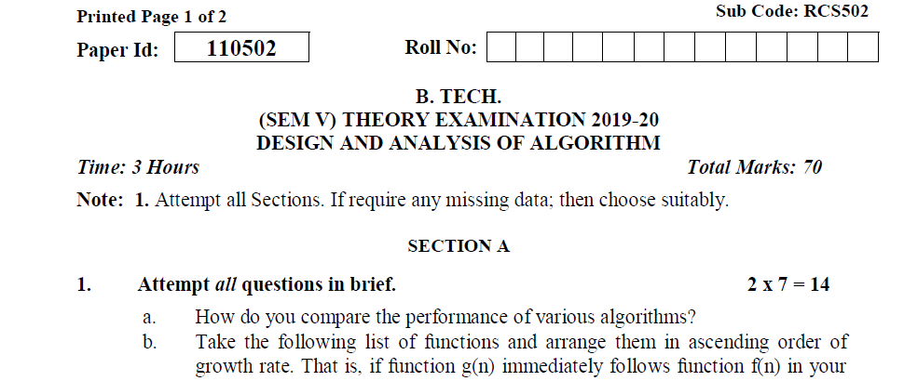
Old Question Papers(2019-2020)

Slide 94
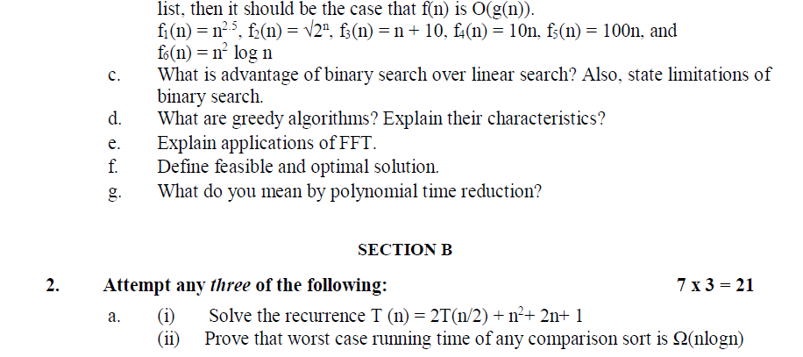
Old Question Papers(2019-2020)

Slide 95
Old Question Papers(2019-2020)

Slide 96
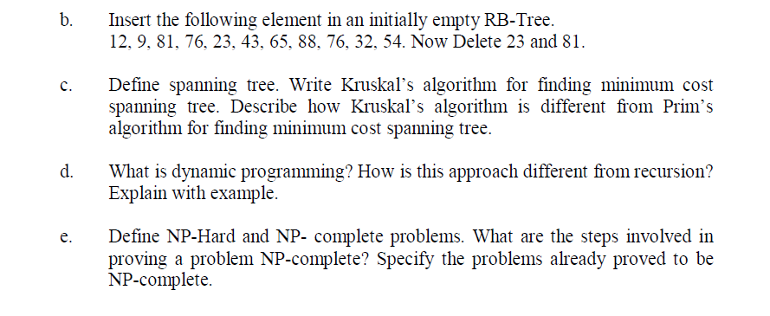
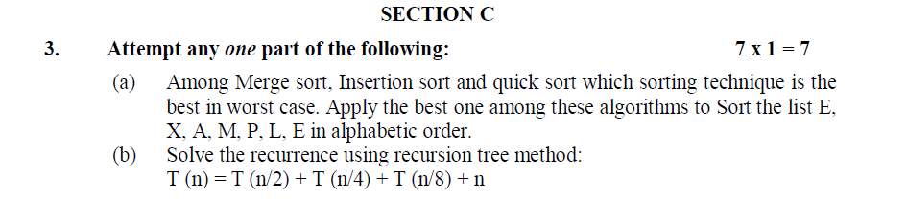
Old Question Papers(2019-2020)

Slide 97
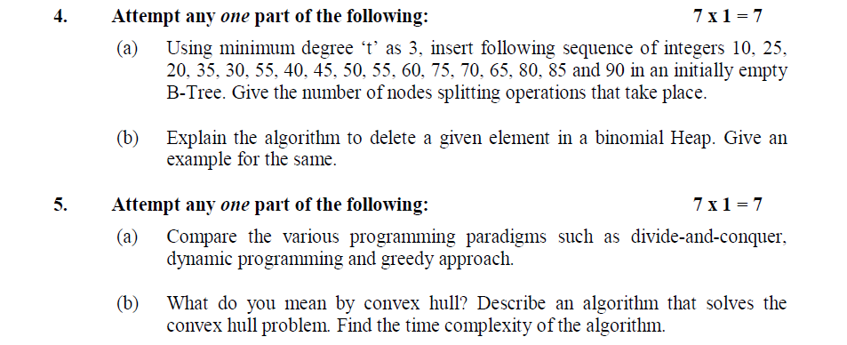
Old Question Papers(2019-2020)

Slide 98
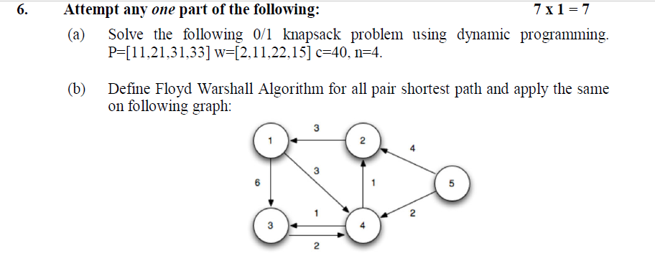
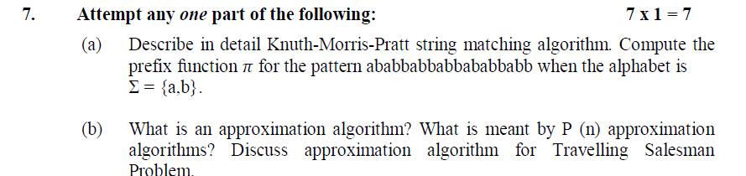
Old Question Papers(2019-2020)

Slide 99
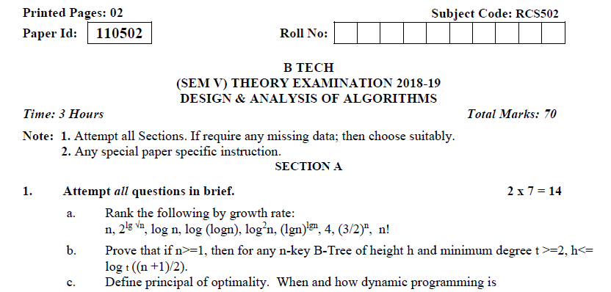
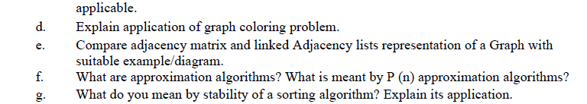
Old Question Papers(2018-2019)

Slide 100
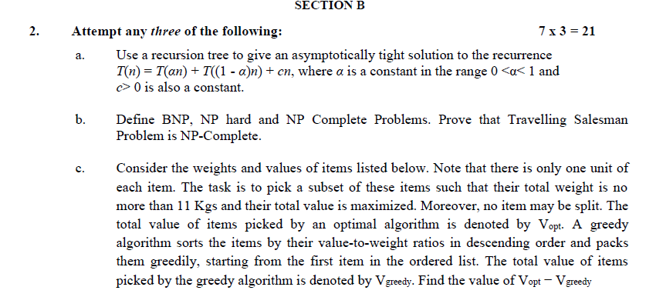
Old Question Papers(2018-2019)

Slide 101
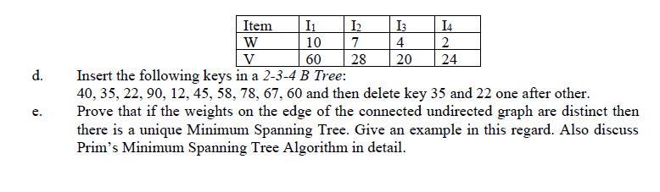
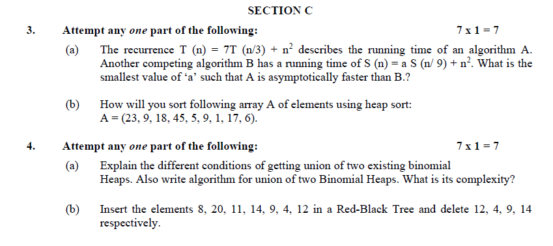
Old Question Papers(2018-2019)

Slide 102
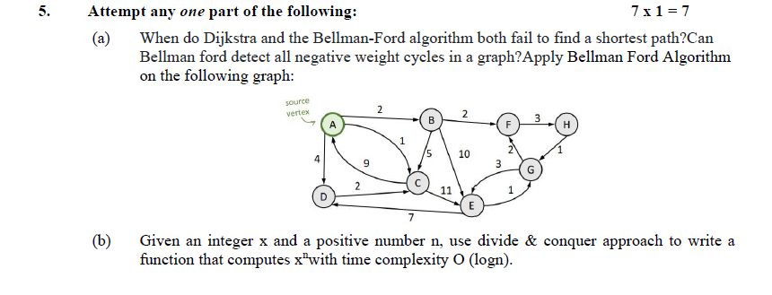
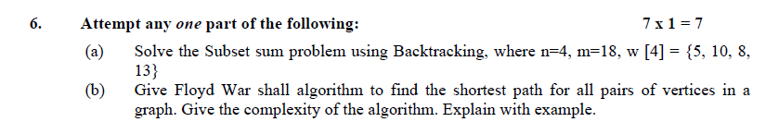
Old Question Papers(2018-2019)

Slide 103
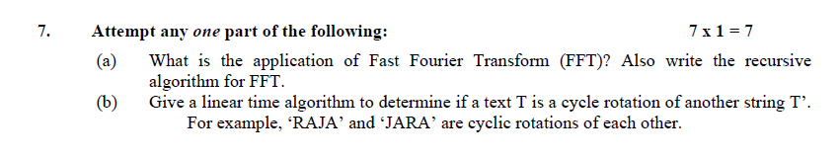
Old Question Papers(2018-2019)

Slide 104
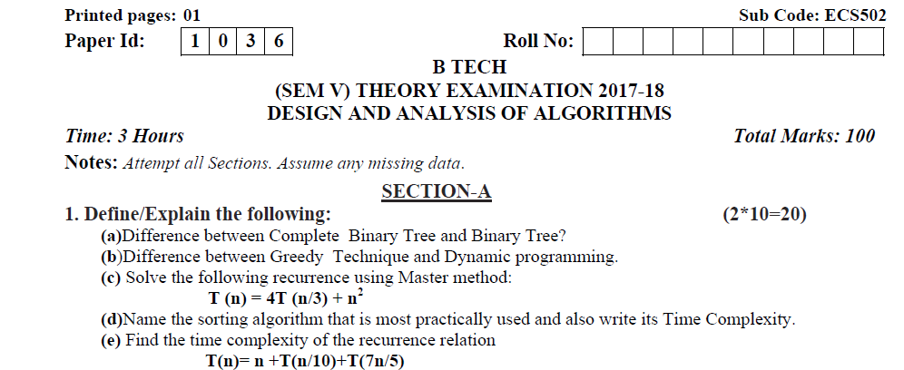
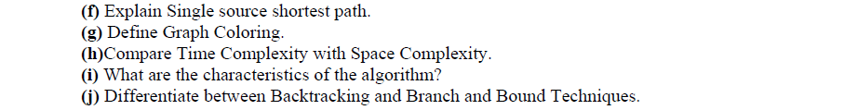
Old Question Papers(2017-2018)

Slide 105
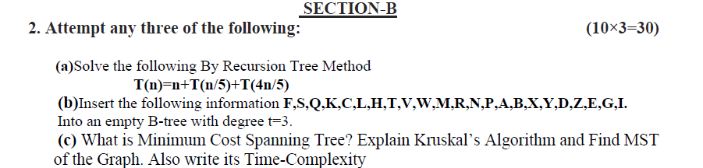
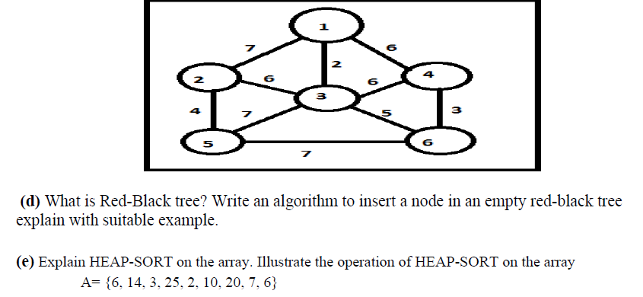
Old Question Papers(2017-2018)

Slide 106
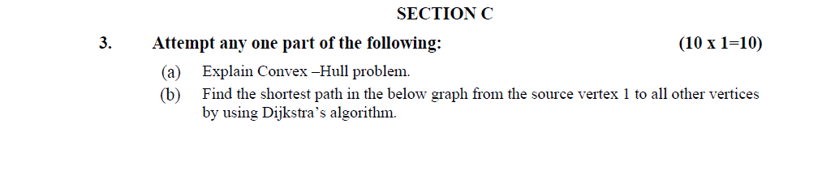
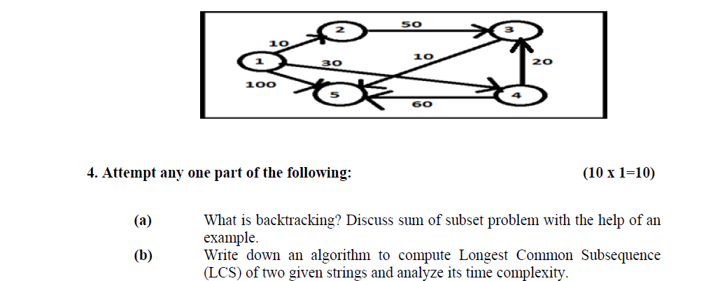
Old Question Papers(2017-2018)

Slide 107
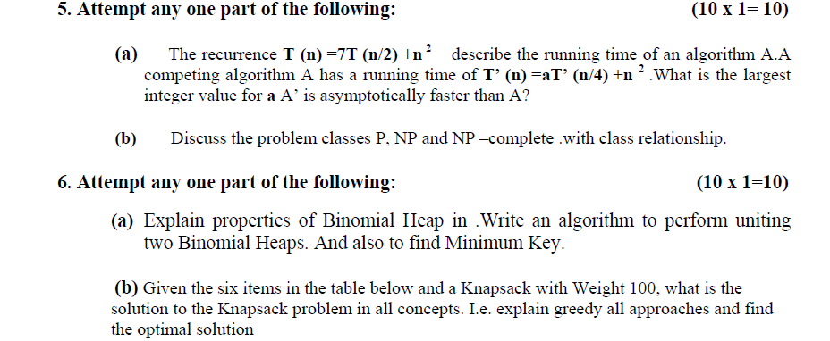
Old Question Papers(2017-2018)

Slide 108
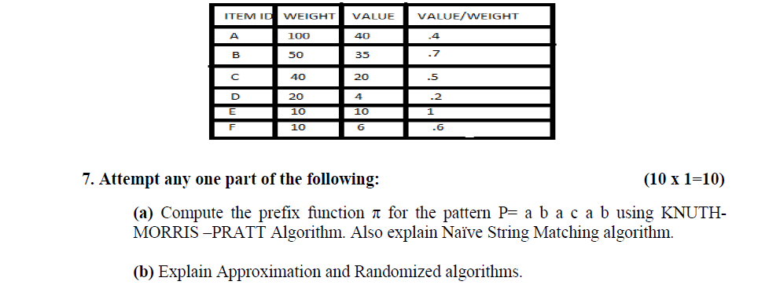
Old Question Papers(2017-2018)

Slide 109
Expected Questions for University Exam
Q1 Differentiate between asymptotic notation O and Ω. [CO1]
Q2 Use a recursion tree to give an asymptotically tight solution to the recurrence T(n) = T(αn) + T((1 - α)n) + cn, where α is a constant in the range 0 <α< 1 and c> 0 is also a constant. [CO1]
Q3 Find the time complexity of the recurrence relation
T(n)= n +T(n/10)+T(7n/5) [CO1]
Q4 Compare Time Complexity with Space Complexity. [CO1]
Q5 What are the characteristics of the algorithm? [CO1]
Q6 Show that the solution to T (n) = 2T (⌊n/2⌋ + 17) + n is O (n lg n).[CO1]
Q7 Solve the recurrence: T (n) = 50 T (n/49) + log n! [CO1]
Q8 Solve the recurrence using recursion tree method: [CO1]
T (n) = T (n/2) + T (n/4) + T (n/8) + n

Slide 110
Expected Questions for University Exam
Q9. Write an algorithm to sort the given array of dement using Quick-
sort. Illustrate the operation of PARTITION procedure on the
array = < 2, 8, 7, 1, 3, 5, 6, 4 > . [CO1]
Q10. Apply BUCKET SORT algorithm on the following array 0 ∙ 78,
0 ∙ 17, 0 ∙ 39, 0 ∙ 26, 0 ∙ 72, 0 ∙ 94, 0 ∙ 21, 0 ∙ 21, 0 ∙ 12, 0 ∙ 23, 0 ∙ 68
[CO1]
Q11. Why Counting sort is called stable sort. [CO1]
Q12. Distinguish between Quick sort and Merge sort, and arrange the
following numbers in increasing order using merge sort
18, 29, 68, 32, 43, 37, 87, 24, 47, 50. [CO1]
Q13. What is divide and conquer strategy and explain the binary
search with suitable example. [CO1]

Slide 111
Recap Of Unit
This is an introductory chapter of Design & Analysis of Algorithm covering the concept, importance and characteristics of algorithms. The complexity and its calculation has been explained. Further, recursion and different methodologies to solve them have also been provided.
In other part of unit different sorting algorithm – Insertion, Heap sort, Quick sort, bucket sort, Radix Sort and Counting sort have been discussed along with their complexities.
.

Slide 112
Thank You

